Slide 1
Haiti 2016

Slide 2
Three areas of focus:
The Boys Home
Haiti Relief
Agricultural Project

Slide 3
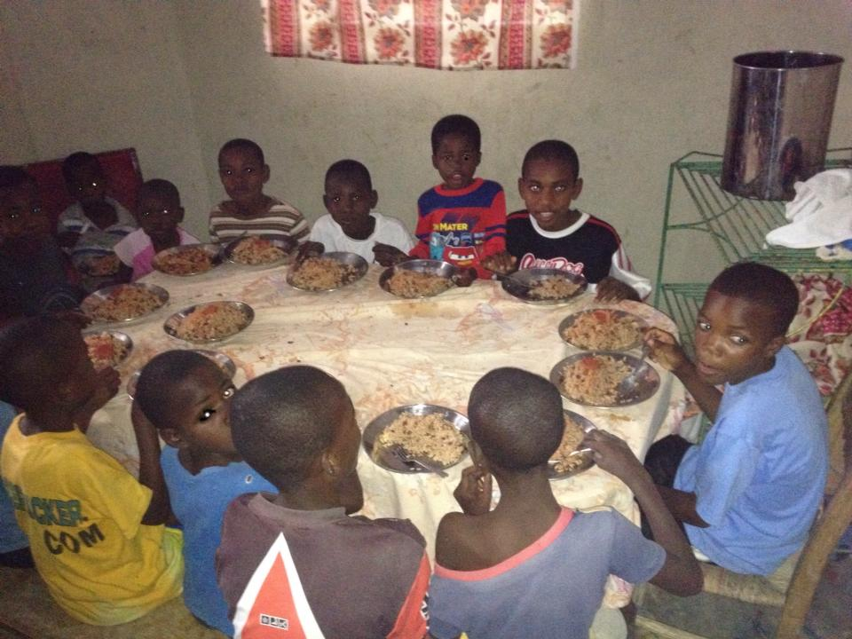
The Boys Home

Slide 5
